Slide 1






2025-2026
COURSE SELECTION
INFORMATION
JHS CLASS OF 2029

Slide 2




MEET YOUR COUNSELORS
A-CLA
MS. BLANCO
CLE-HAN
MS. VELIZ
HAR-MAC
MS. ELLER
MAD- PIE
MS. BENTLEY
PIF- S
MS. BEVERLY
T-Z
MS. MARSHALL
COLLEGE & CAREER
MS. STILLINGER
Counselor splits are determined at the start of the year and vary based on student enrollment.

Slide 3





GRADUATION REQUIREMENTS
22 FOUNDATION CREDITS
+ 4 ENDORSEMENT CREDITS
= 26 TOTAL CREDITS

Slide 4







THE 5 ENFORSEMENTS
STEM
(SCIENCE,
TECHNOLOGY, ENGINEERING, MATH
MULTIDISCIPLINARY STUDIES
PUBLIC SERVICES
BUSINESS AND
INDUSTRY
ARTS
AND
HUMANITIES

Slide 5


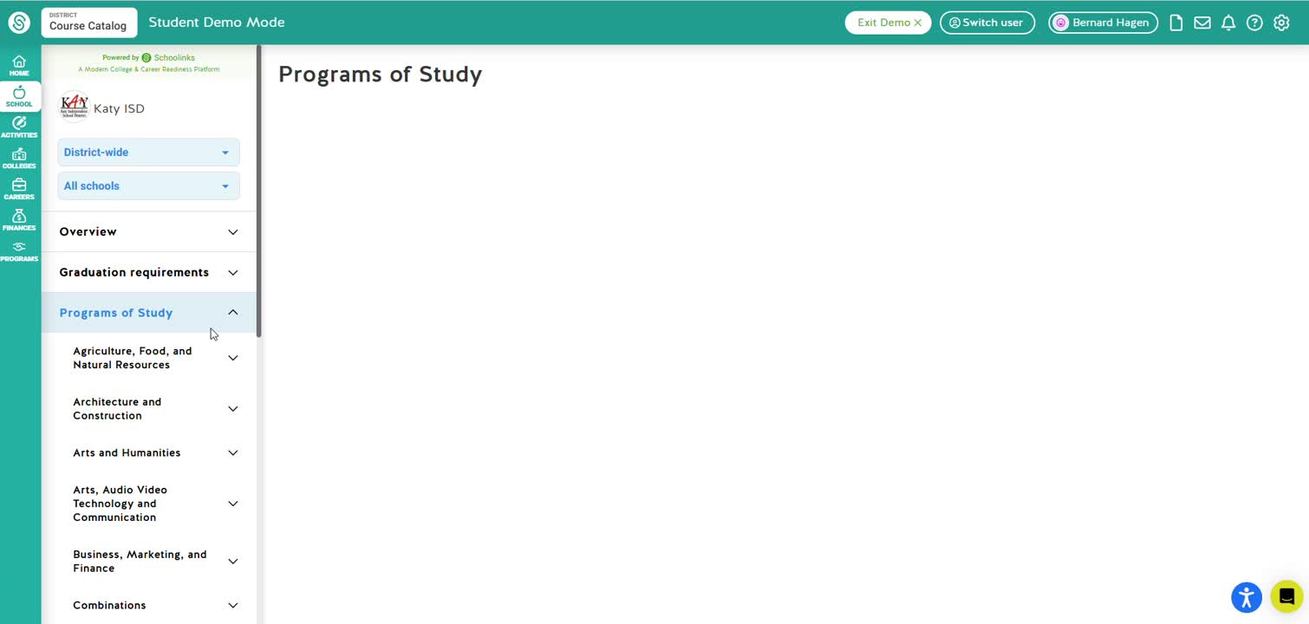
ENDORSEMENT PATHWAYS
YOU CAN FIND A LIST OF PATHWAYS FOR EACH ENDORSEMENT ON THE COURSE CATALOG IN SCHOOLINKS. THEY DETAILS ALL COURSES NEEDED TO FULLFILL EACH PROGRAM OF STUDY FOR EACH ENDORSEMENT.

Slide 6





TYPES OF CLASSES
9TH GRADE
DURING THE 7 PERIOD HS DAY:
MAY CHOOSE UP TO 1 IDR COURSE
Traditional face-to-face
Virtual Instructional day request (IDR)- You choose!
IDR COURSES SCHEDULED WITH STUDY HALL DURING THE DAY
Virtual instructional day Supplemental (IDS)- Offered if course isn’t available on campus or select circumstances.
MAY CHOOSE UP TO 2 TUITION BASED VIRTUAL COURSES
OUTSIDE OF THE 7 DAY HS DAY:
Tuition- Based Virtual Courses- current KVS
KSAT Virtual Courses

Slide 7



Slide 8

CHOOSE ONE ENGLISH COURSE:
ENGLISH 1 ACADEMIC
ENGLISH I KAP (KATY ADVANCED PLACEMENT)
ENGLISH I KAP/GT (COURSE FOR GT STUDENTS)

Slide 9

CHOOSE ONE SOCIAL STUDIES COURSE:
WORLD GEOGRAPHY
WORLD GEOGRAPHY KAP (KATY ADVANCED PLACEMENT)
AP HUMAN GEOGRAPHY
AP HUMAN GEOGRAPHY (GT STUDENTS WILL TAKE THIS COURSE)
GT Students: If you take World Geography KAP over the summer, you will be exited from GT for Social Studies.

Slide 10

CHOOSE ONE MATH COURSE:
ALGEBRA 1
GEOMETRY (ONLY IF YOU TOOK ALGEBRA IN 8TH GRADE)
GEOMETRY KAP (KATY ADVANCED PLACEMENT)
GEOMETRY KAP/ GT (GT STUDENTS ONLY)
ALGEBRA II (ONLY IF ALGEBRA & GEOMETRY IN JR HIGH)
ALGEBRA II KAP (KATY ADVANCED PLACEMENT)
ALGEBRA II KAP/ GT (GT STUDENTS ONLY)

Slide 11
CHOOSE ONE SCIENCE COURSE:
BIOLOGY
BIOLOGY KAP (KATY ADVANCED PLACEMENT)
BIOLOGY KAP/ GT (GT STUDENTS ONLY)

Slide 12








CHOOSING PE COURSES AND FINE ARTS
1 PE OR ATHLETICS
BAND/ COLOR GUARD/ DANCE
FINE ARTS
  STUDENT-ATHLETES MUST CHOOSE ONLY ONE ATHLETICS PROGRAM DURING ONLINE COURSE SELECTION. FOR MULTI-SPORTS ATHLETES, YOU WILL SELECT THE SPORT THAT COMES FIRST IN THE SECOND YEAR, AND THE COACHES AND COUNSELORS WILL WORK TOGETHER TO MOVE STUDENTS TO THEIR 2ND SPORT ONCE THE 1ST SPORT SEASON IS OVER.
  STUDENTS CAN ENROLL IN BOTH A FINE ARTS COURSE AND A PE/ATHLETICS COURSE DURING THE SAME YEAR.
  BAND/ COLOR GUARD/DANCE DO HAVE A PE CREDIT OPTION (TALK TO OUR DIRECTOR AND/OR COUNSELOR TO MKE SURE COURSE CODE IS CORRECT!)

Slide 13






CHOOSING A FOREIGN LANGUAGE:
  STUDENTS WILL NEED 2 YEARS OF LEVEL 1 AND LEVEL II OF A FOREIGN LANGUAGE. IF YOU ARE TAKING SPANISH 1 IN 8TH GRADE, YOU WILL TAKE SPANISH II IN 9TH. SPANISH FOR SPANISH SPEAKERS 1 AND 2, YOU WILL TAKE SPANISH FOR SPANISH SPEAKERS 3 AND 4.
  SOME STUDENTS CAN WAIT TO TAKE THEIR FOREIGN LANGUAGE IN 10TH GRADE IF THEY HAVE NOT STARTED IN THE 8TH GRADE.

Slide 14


SAMPLE 9TH GRADE COURSE SELECTIONS
POSSIBLE ELECTIVE CHOICES:
1.
LANGUAGE COURSE
ENGLISH 1
2.
ATHLETICS OR PE COURSE
ALGEBRA
3.
WORLD GEOGRAPHY
FINE ARTS COURSE
4.
BIOLOGY
PRINCIPLES CLASS
COURSE ALIGNED WITH STUDENT INTEREST/STRENGHT
5.
ELECTIVE
6.
ELECTIVE
Students should try to take courses that fulfill the graduation requirements so there is room in their schedule later in high school.
7.
ELECTIVE

Slide 15
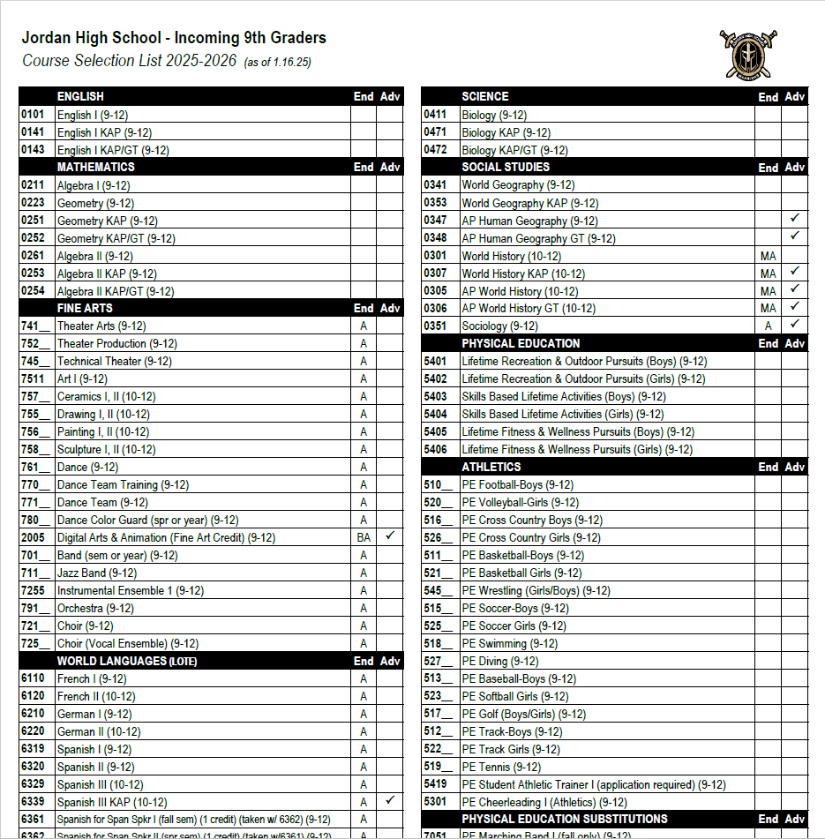
COURSE OFFERINGS FOR CURRENT 8TH GRADERS ATTENDING JORDAN HIGH SCHOOL
COURSE SELECTION WEBSITE

Slide 16

CHOOSING COURSES FOR NEXT YEAR
Students select courses in SchooLinks
(KatyCloud)before 2/4/25.
Students will meet with counselor to review credits and finalize course requests
Choose from the 4 required subject areas:
English
Math
Science
Social Studies
Choose 3 elective courses to fill all 7 class periods.
Courses labeled (sem) are semester courses. You will need to select 2
Please plan classes before Feb. 4th. Counselors will start meeting with students on Feb 4th.

Slide 17


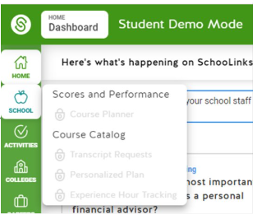

HOW TO GET TO SCHOOLINKS
SCHOOL
SCHOOLINKS
MY KATY CLOUD
COURSE PLANNER

Slide 18

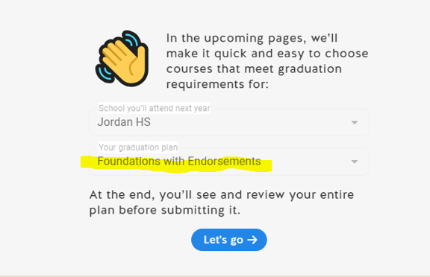
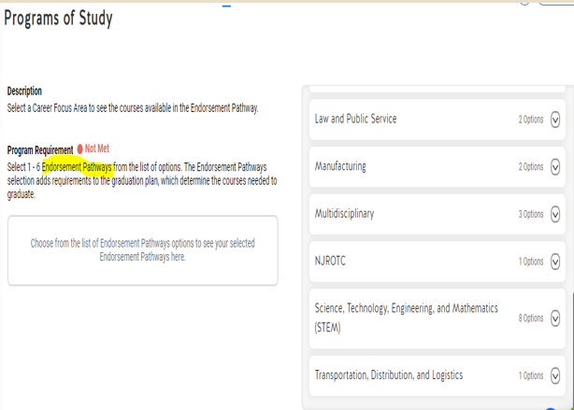
IF ASKED, YOU WILL CHOOSE FOUNDATION WITH ENDORSEMENT PLAN
YOU WILL BE ASKED TO PICK AN ENDORSEMENT. YOU WILL NEED TO STUDY THESE AND USE THE COUSE CATALOG. IF UNSURE, PICK MULTIDISCIPLINARY

Slide 19

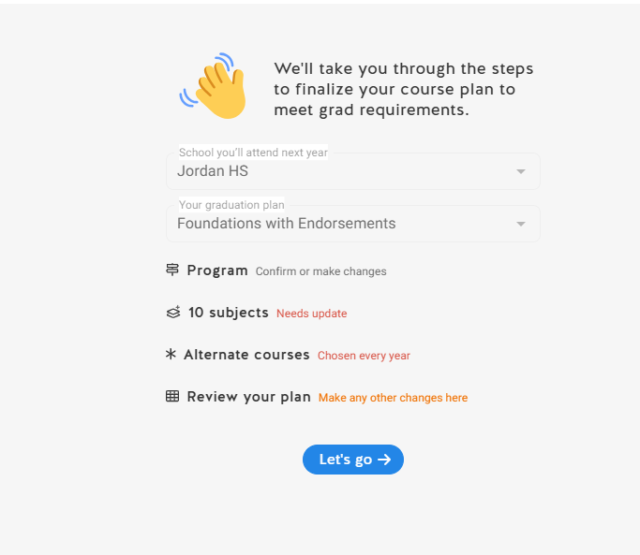



USING SCHOOLINKS FOR COURSE SELECTION
CAREER & TECHNICAL
EDUCATION
(CTE)
PROGRAMS OF
STUDY
PHYSICAL EDUCATION
MATH
SCIENCE
SPEECH
ALTERNATES
ENGLISH
SOCIAL STUDIES
LANGUAGES OTHER THAN ENGLISH
FINE
ARTS
HEALTH
ELECTIVES
SUMMARY
  SELECT A PATHWAY THAT MATCHES YOUR FUTURE CAREER INTERESTS. THIS WILL HELP YOU PLAN FOR AN ENDORSEMENT
  CHOOSE COURSES FOR EACH SUBJECT INCLUDING YOUR ALTERNATE COURSES.
  CHECK TO MAKE SURE YOU HAVE MET REQUIREMENTS FOR YOUR CHOSEN COURSES

Slide 20
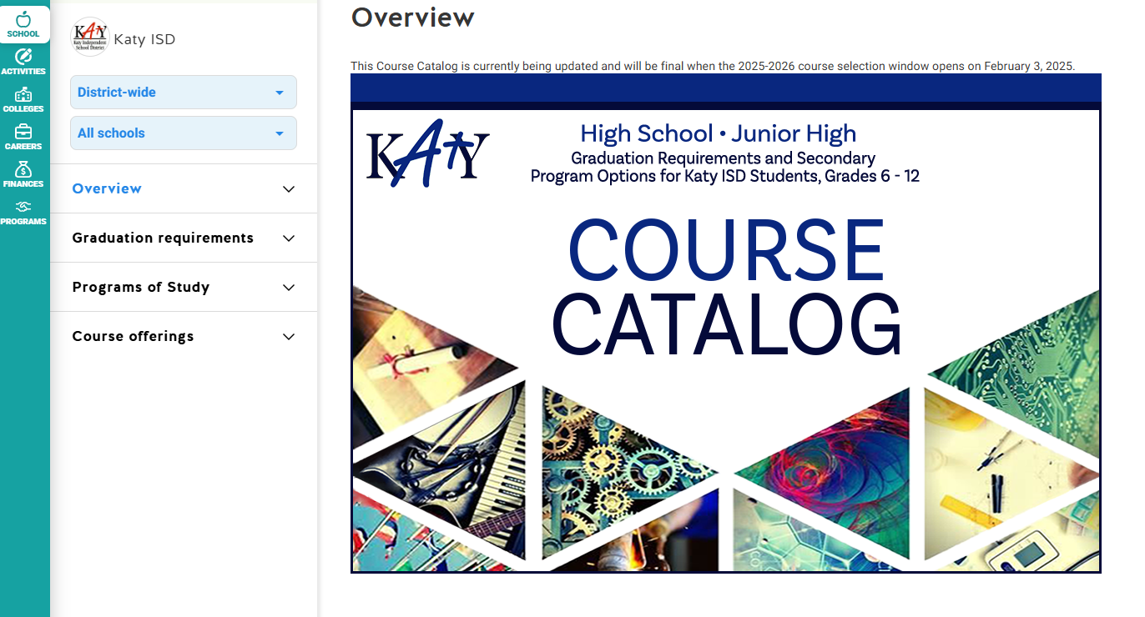

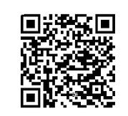
USE THE COURSE CATALOG IN SCHOOLINKS. THE COURSE CATALOG EXPLAINS WHAT EACH ENDORSEMENT AND PATHWAY IS ALONG WITH COURSES THAT FULFILL THAT CHOSEN AREA.
COURSE CATALOG

Slide 21

3
LIST ALTERNATE CHOICES IN THE ORDER OF PREFERENCE BECAUSE ELECTIVE CLASSES ARE NOT GUARANTEED.
1
COURSE PLANNER IS OPEN FOR YOU TO SELECT COURSES ON SCHOOLINKS .
4
2
COUNSELORS WILL COMMUNICATE COURSE VERIFICATION TIMELINE. REMEBER THIS IS THE LAST OPPORTUNITY TO MAKE CHANGES TO YOUR CLASSES.
COUNSELORS WILL MEET WITH STUDENTS TO REVIEW SELECTIONS & ANSWER QUESTIONS
TIMELINE

Slide 22

KATY ISD SCHEDULE CHANGE POLICY
Once course verification has been completed, schedule changes for the 2025-2026 school year will be allowed only in the following cases:
ERROR IN SCHEDULE BY THE SCHOOL (DATA ENTRY ERROR).
STUDENT HAS NOT MET COURSE PREREQUISITES.
STUDENT HAS ALREADY EARNED CREDIT FOR THE COURSE
CHANGE IN PROGRAM (ATHLETICS, FINE ARTS, ETC).
LEVEL CHANGES AS RECOMMENDED BY THE TEACHER AND COUNSELOR, WITH PARENT AND PRINCIPAL APPROVAL.
STUDENT DID NOT MEET STANDARD ON STAAR/EOC EXAM.

Slide 23





QUESTIONS?
IF YOU HAVE QUESTIONS AFTER TODAY, PLEASE ASK YOUR 8TH GRADE COUNSELOR.
THEY WILL BE ABLE TO ANSWER YOUR QUESTIONS

